Slide 1
Wind Turbine
Tamara Roberson
Candidate for Associate Software Engineer

Slide 2


Who Am I?
Tamara Roberson
Graduating from WSU Everett with a BSEE and CS minor this week
Starting a career in embedded software
Hobby: Board Games

Slide 3
Who Are You?
Name
Specialization
Not your job title
What are you the “go to” person for?
React? Analog ICs? LaTeX? Regulations?
Hobbies
Open-Source Software? Video Games? Hiking? Museums?

Slide 4
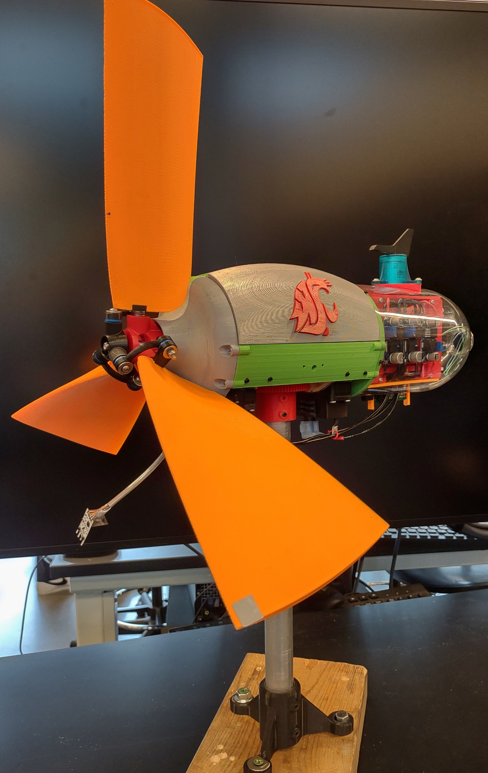
The Team
Senior Design Project and Engineering Club Team
US Department of Energy Collegiate Wind Competition
Team of 3 EEs, 1 ME
Club also includes several Business and Communications students for outreach and wind farm business analysis

Slide 5

Design Considerations
Collegiate Wind Competition rules
Offshore wind turbine designed to be installed in the Gulf of Mexico
Primary goal: stable, clean 48V dc power
Secondary goals:
Emergency stop and restart
Power Arduino controller
Yaw control to realign turbine into the wind

Slide 6
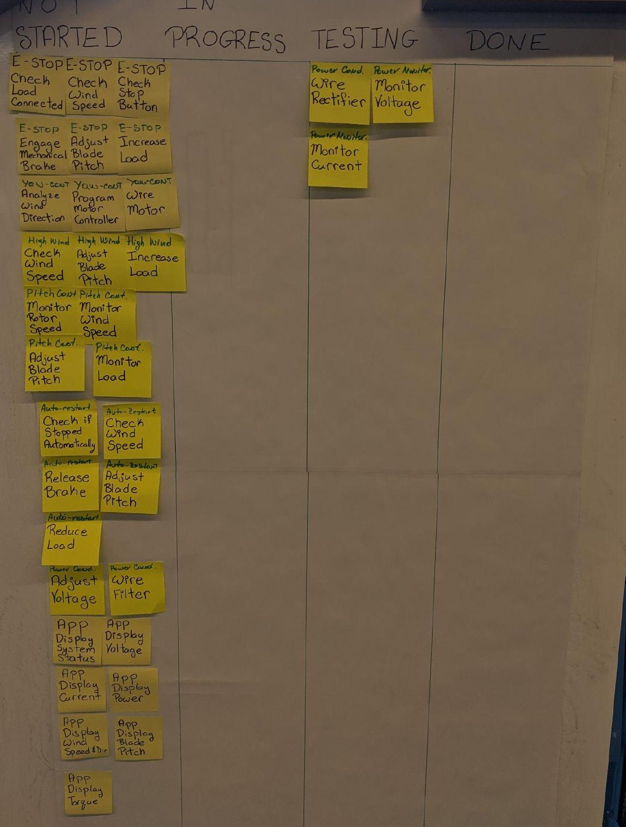
Project Management
Wrote user stories
“As a,” “I want to,” “So that”
Analyzed requirements
Created tasks
Post-It note Kanban first
Moved to Trello

Slide 7
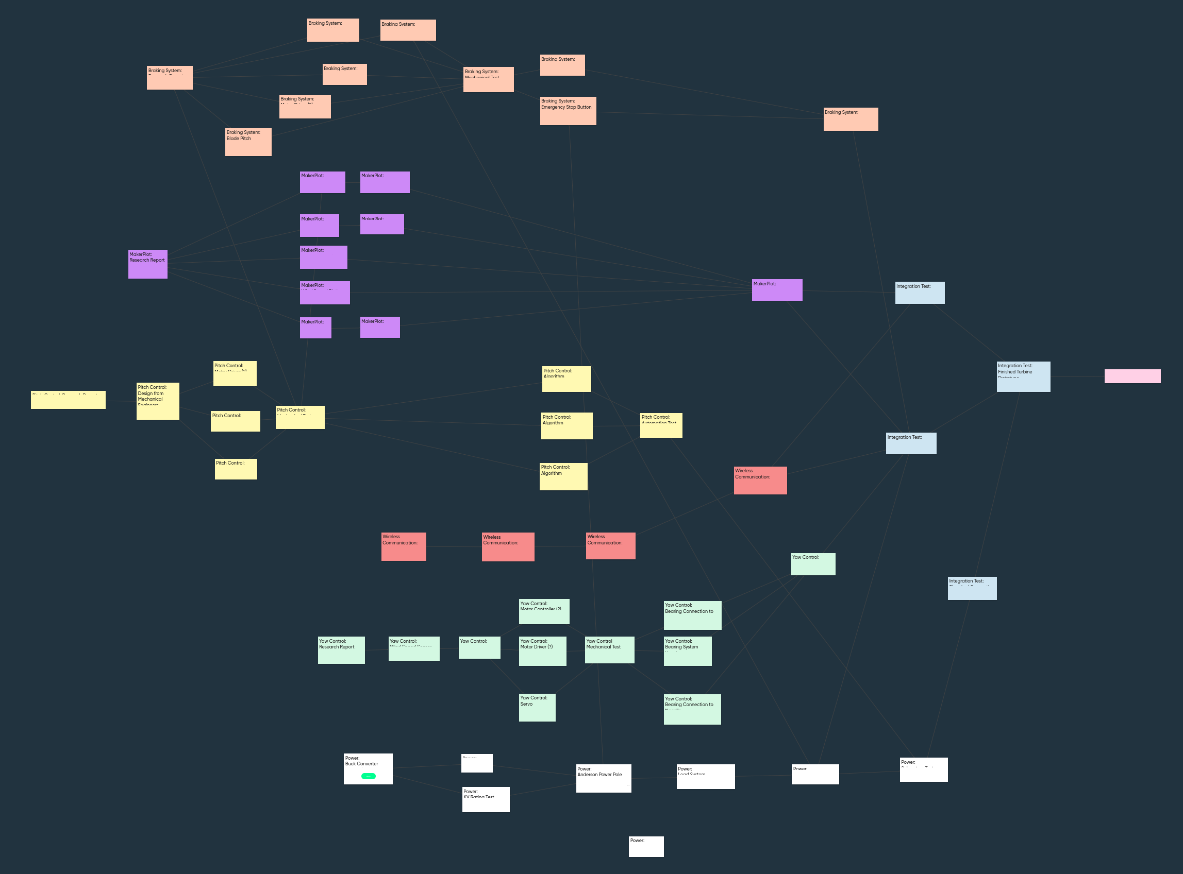
Project Management
Initial work was based on a broad breakdown of subsystems
This made it difficult to understand what needed to be done
For the second semester, I named myself as project manager
Studied Project Management on Udemy

Slide 8
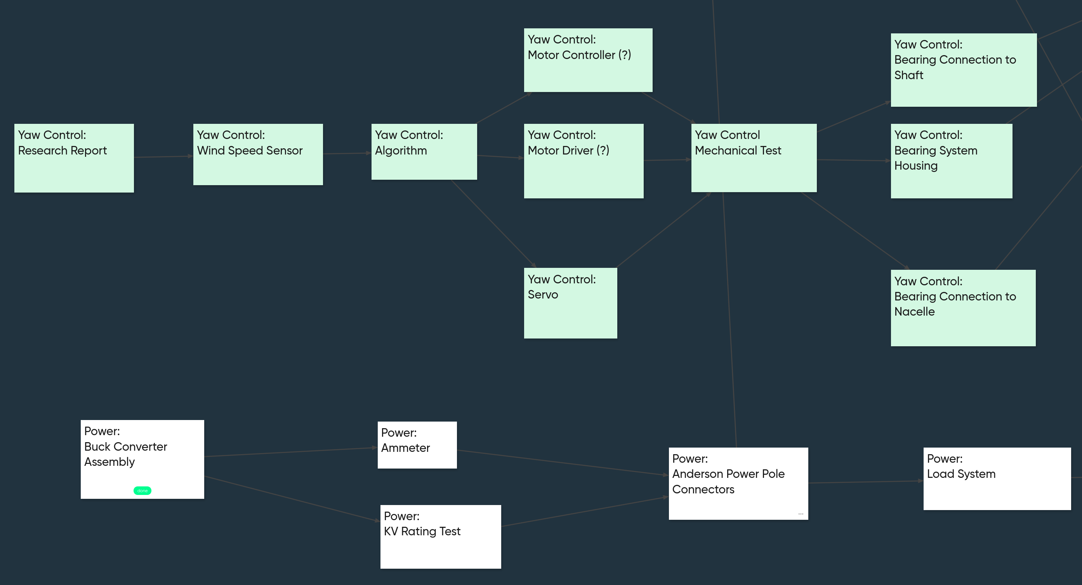
Project Management

Slide 9
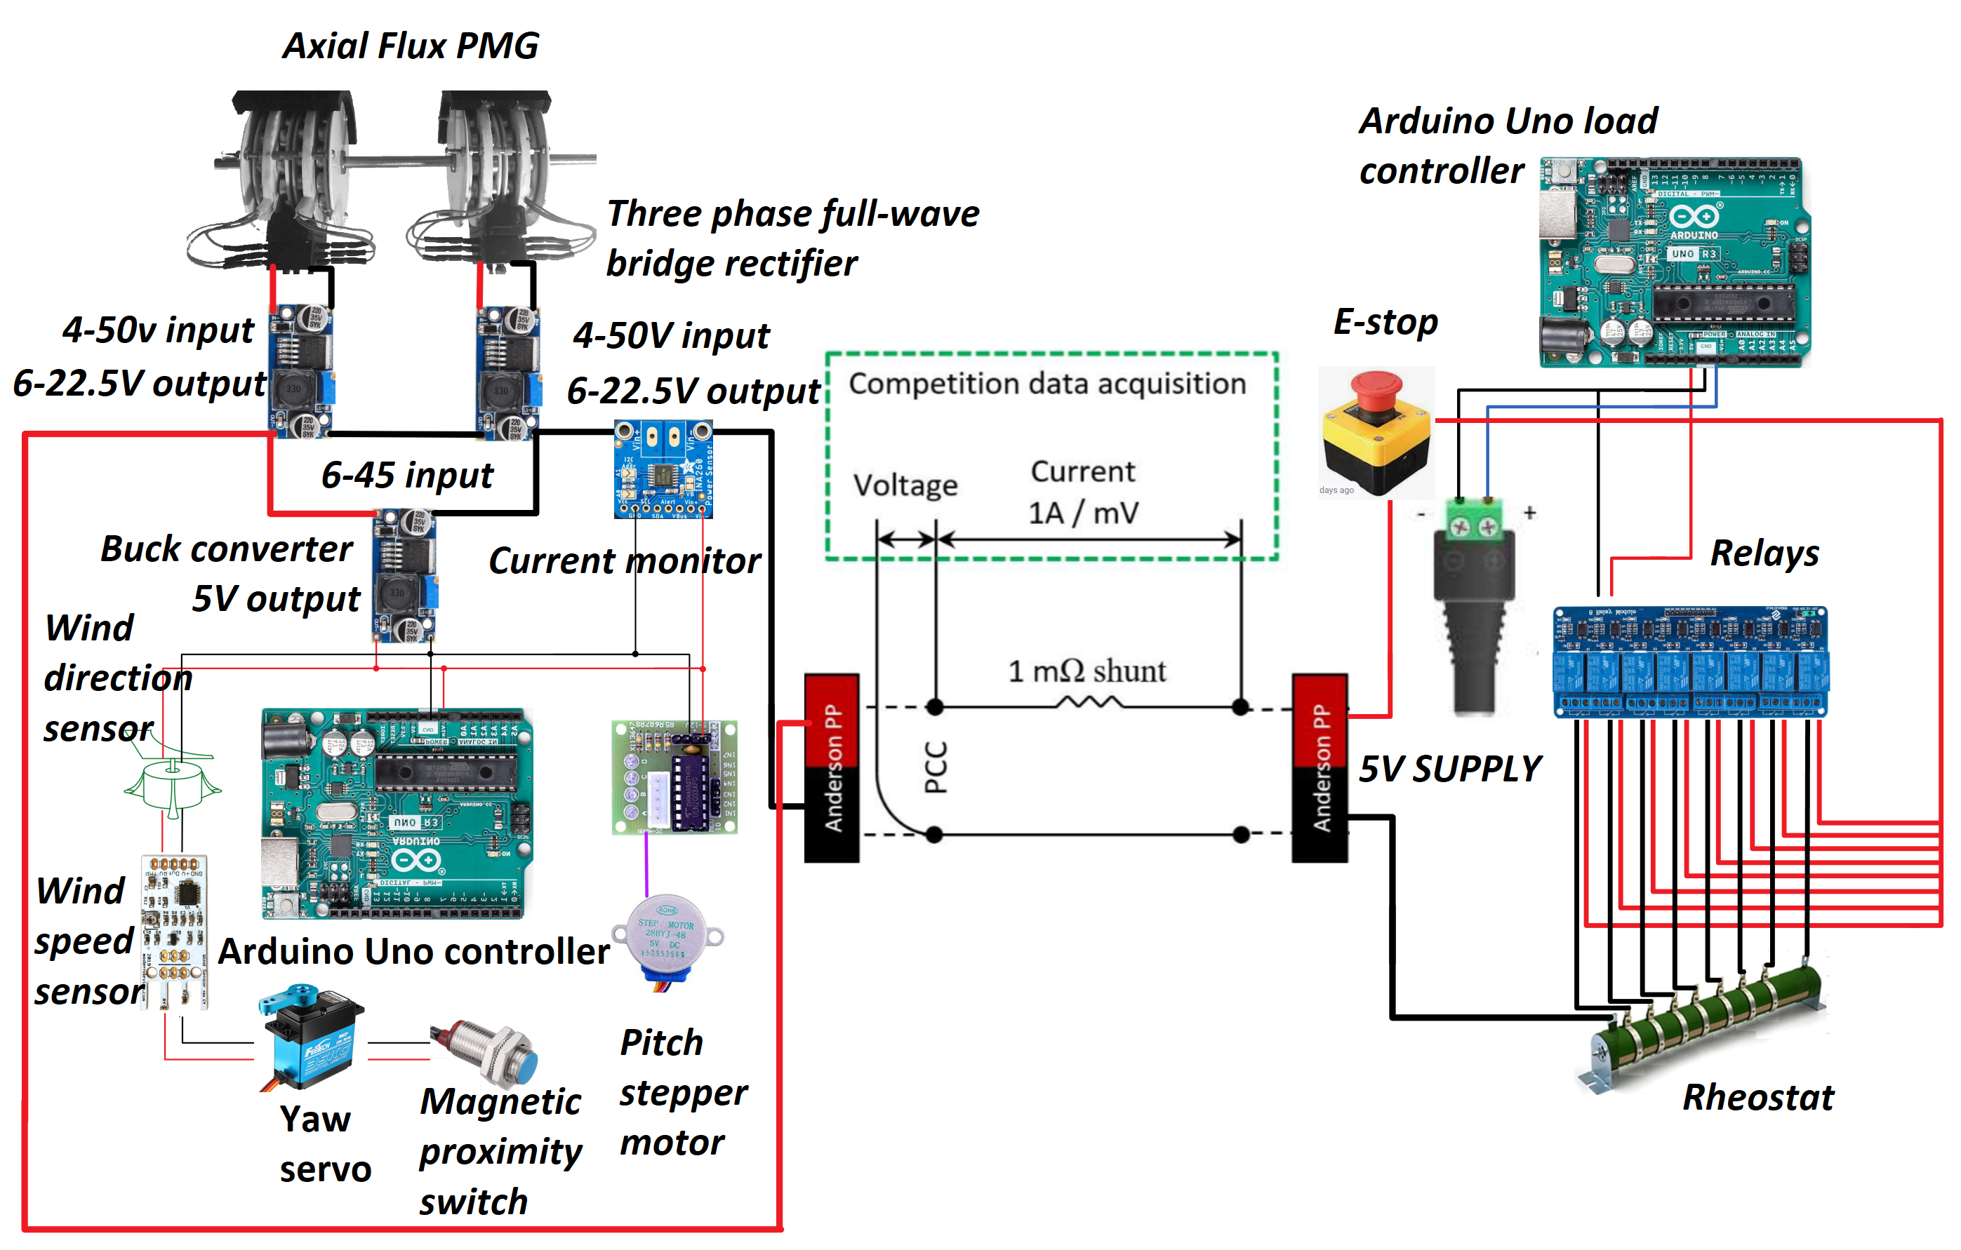
Subsystems
Power Generation
Load Control
Blade Pitch Control
Yaw Control
Wind Speed Sensor
Software and
Communication
Integration Testing

Slide 10
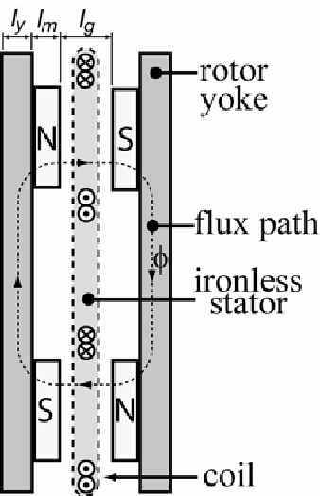
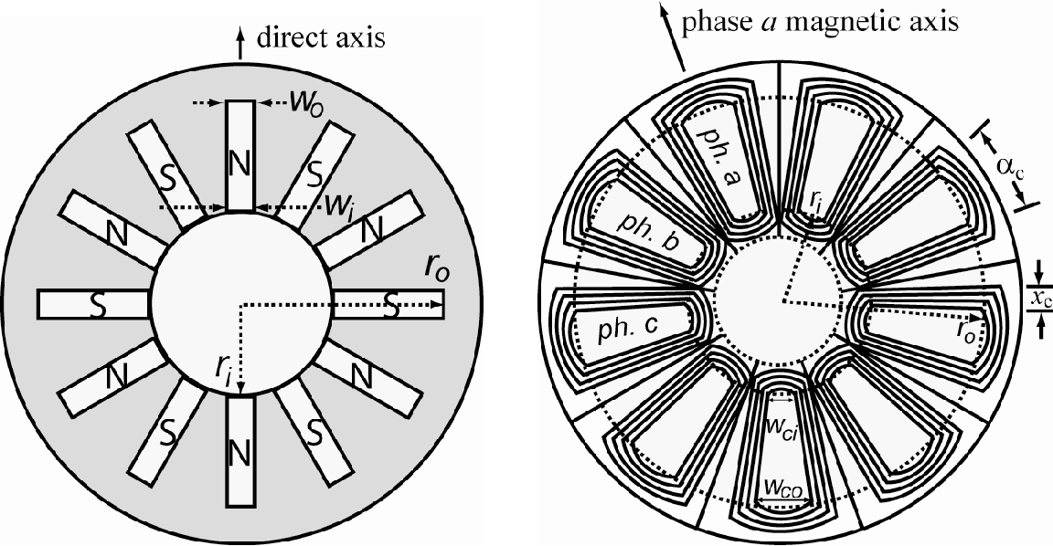
Power Generation
Axial-Flux Permanent Magnet Generator (AFPMG)
Price, G., Batzel, T.D., Comanescu, M., & Muller, B.A. (2008). Design and Testing of a Permanent Magnet Axial Flux Wind Power Generator.

Slide 11
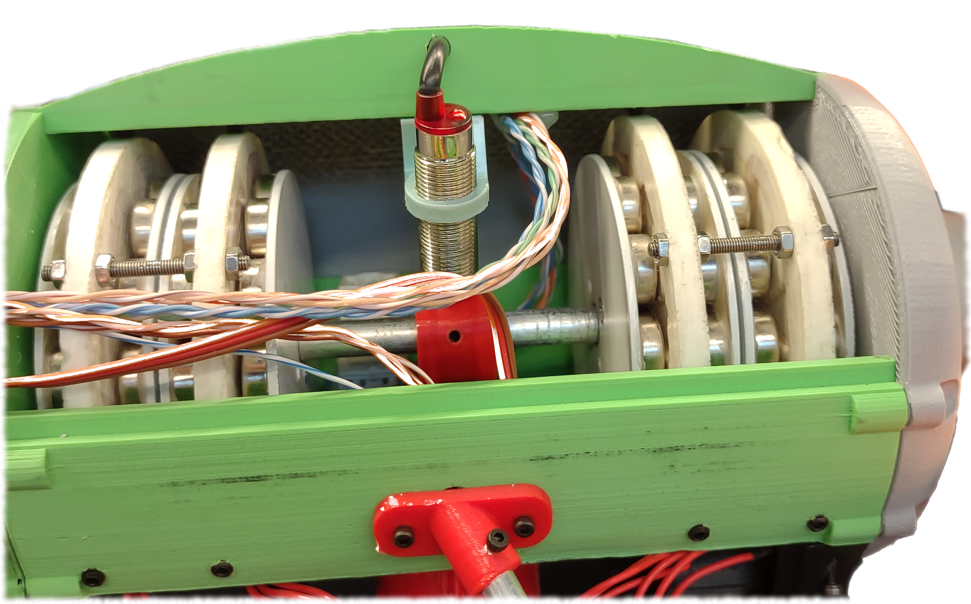
Power Generation
Needed low cogging torque
4 generators in series
Weight balanced over column
Produces high torque, even at low speed

Slide 12
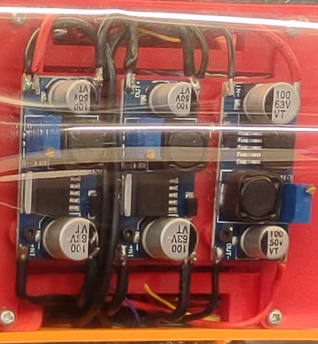
Power Generation
Two buck converters ensure the produced power remains just under 48V
48V maximum allowed for safety
One buck converter at 5V for Arduino
Problem: Two buck converters that are in series require 4.5V each
9V but Ardiuno is 5V

Slide 13
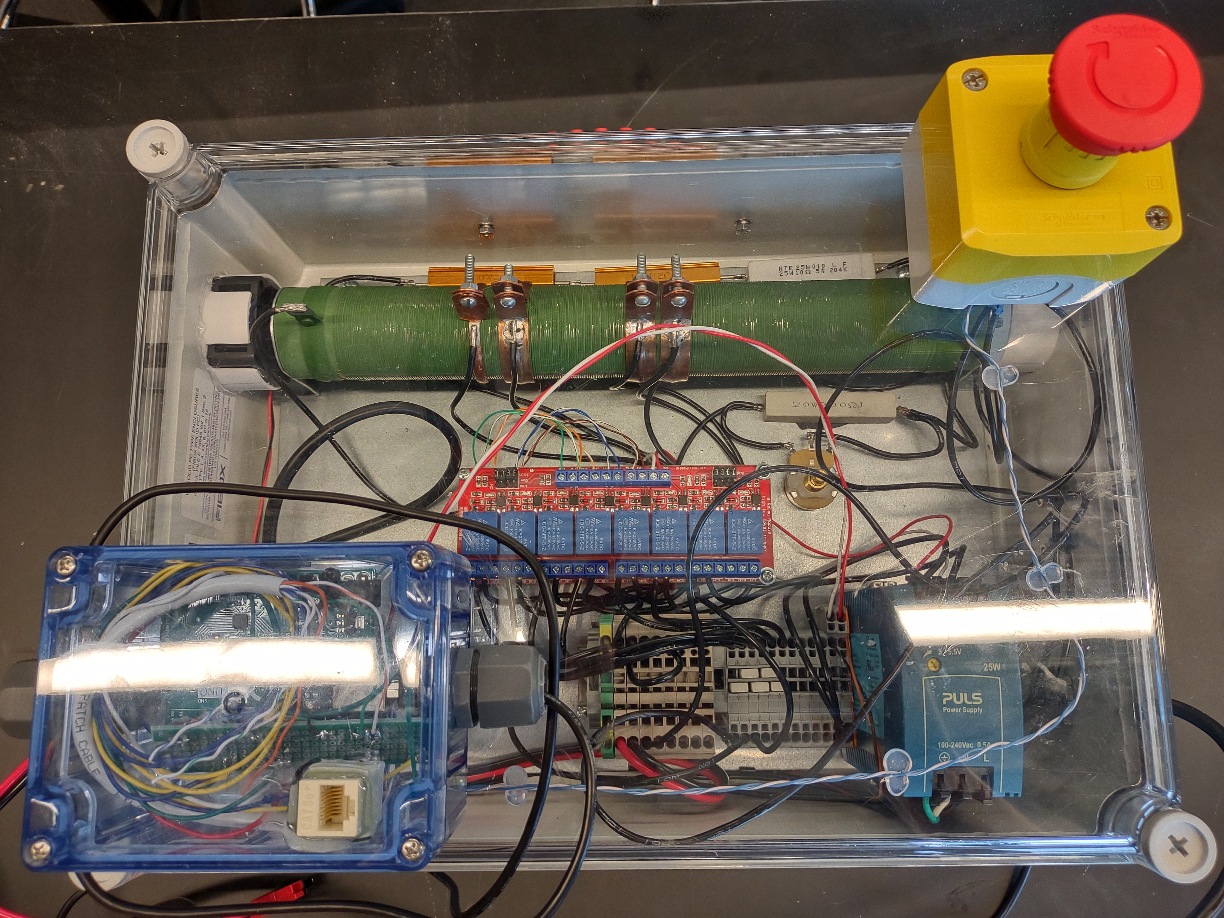
Load Control
Linear rheostat
400W, 200Ω
8 bank optically-isolated relay
Emergency stop button
Arduino controller
Ethernet port

Slide 14
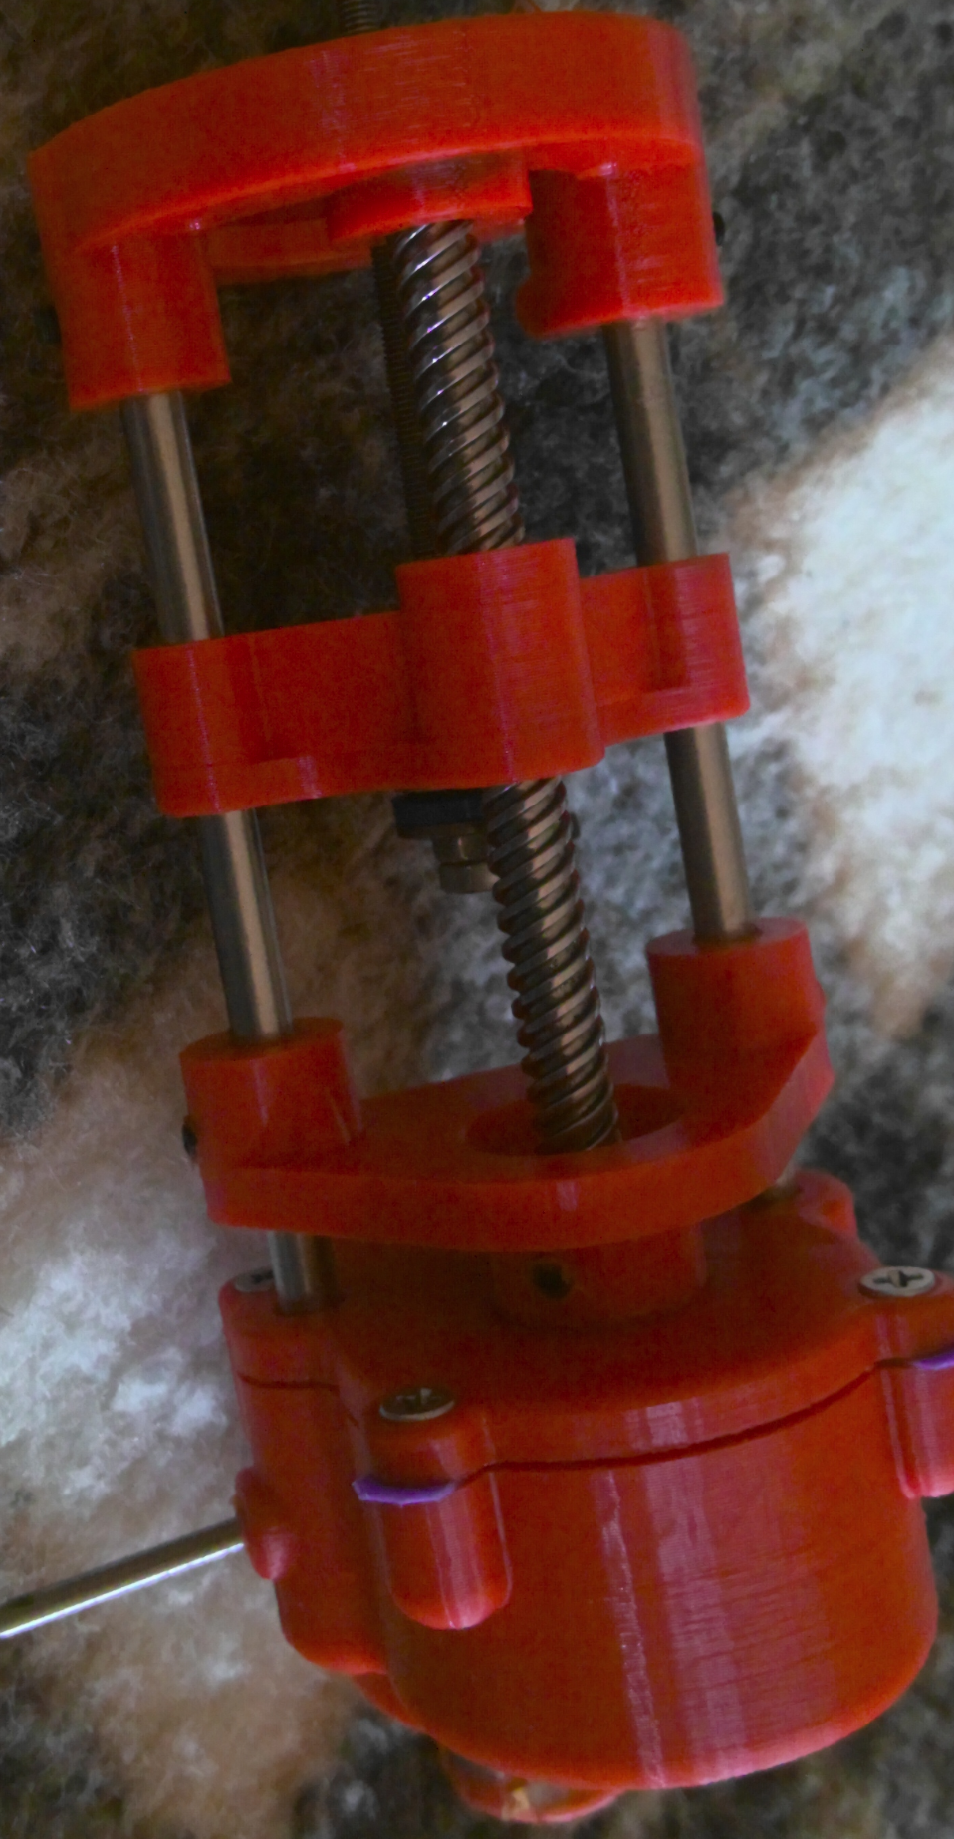
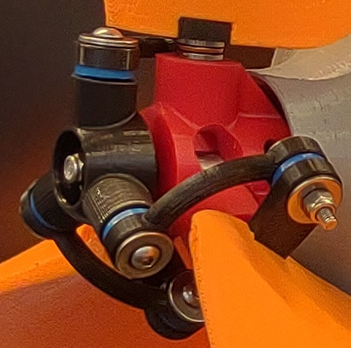
Blade Pitch Control
Servo motor was imprecise
Stepper motor could be configured
Control system monitors the rate of change in speed

Slide 15
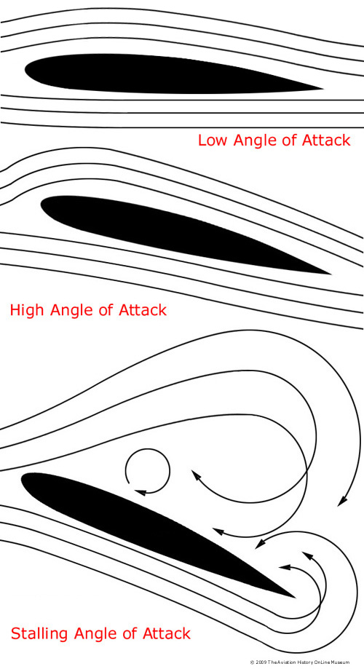
Blade Pitch Control
Turbine blades rely on the same Bernoulli’s principle as airplane wings
Increasing the angle of attack improves lift, creating torque
But too high and the laminar flow is broken, causing the turbine to stall
“Angle of attack,” The Aviation Online History Museum, Jun. 1, 2015. [Online]. Available: http://www.aviation-history.com/theory/angle_of_attack.htm.

Slide 16
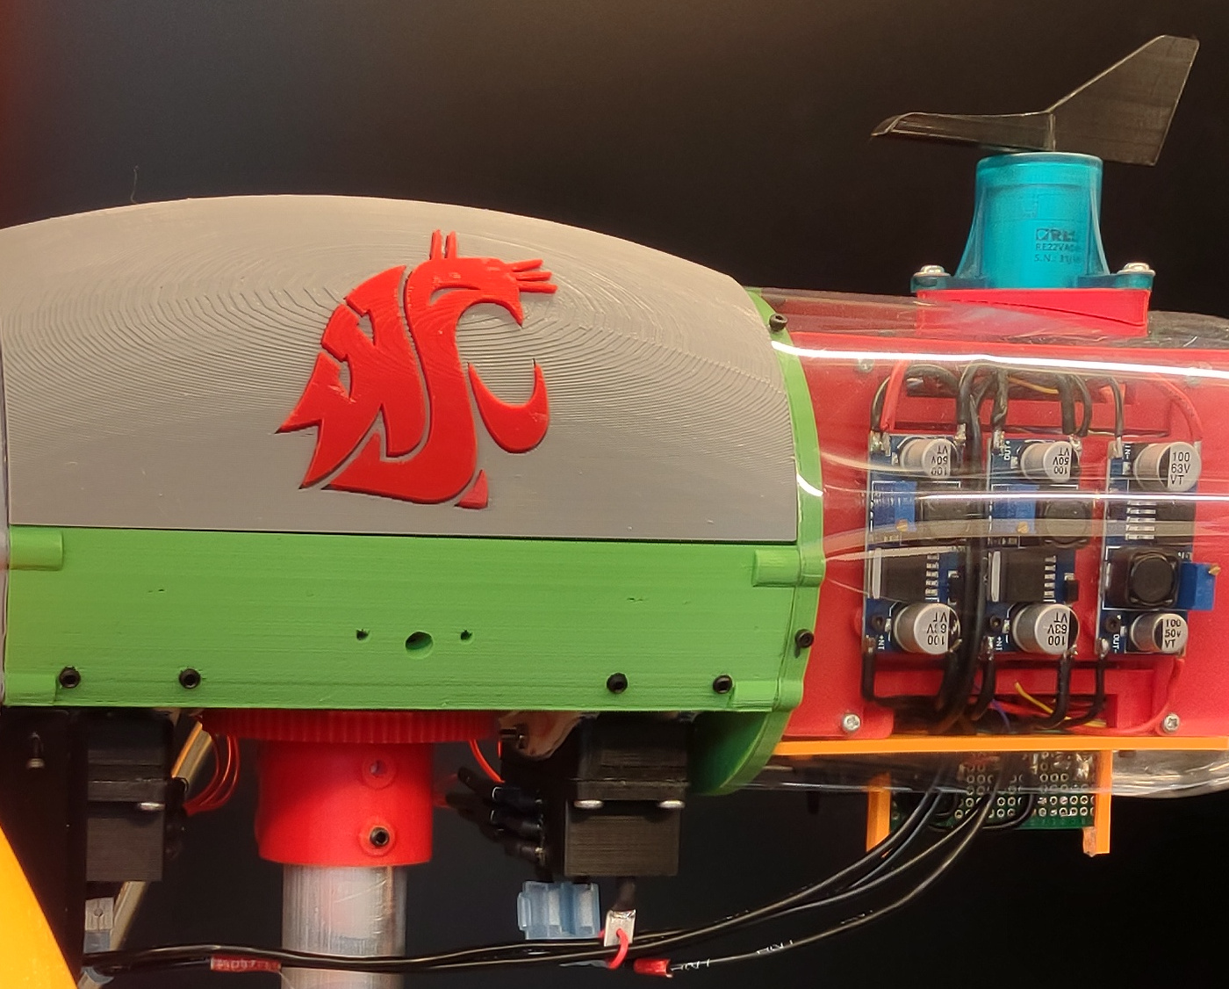
Yaw Control
Turbine must rotate to face the wind
Active yaw system provides more control
Wind direction sensor triggers continuous servo motor
7:1 gear reduction

Slide 17
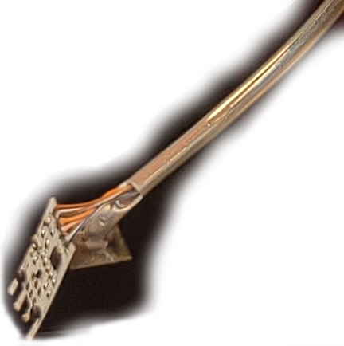
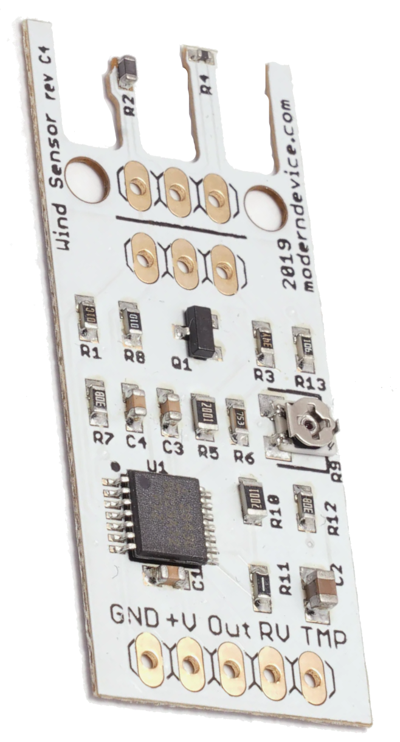
Wind Speed Sensor
Hot wire anemometers measure the temperature of a fine wire
Tried 12V hot wire
Too high
Tried cup anemometer
Where to mount?
Selected 5V hot wire

Slide 18
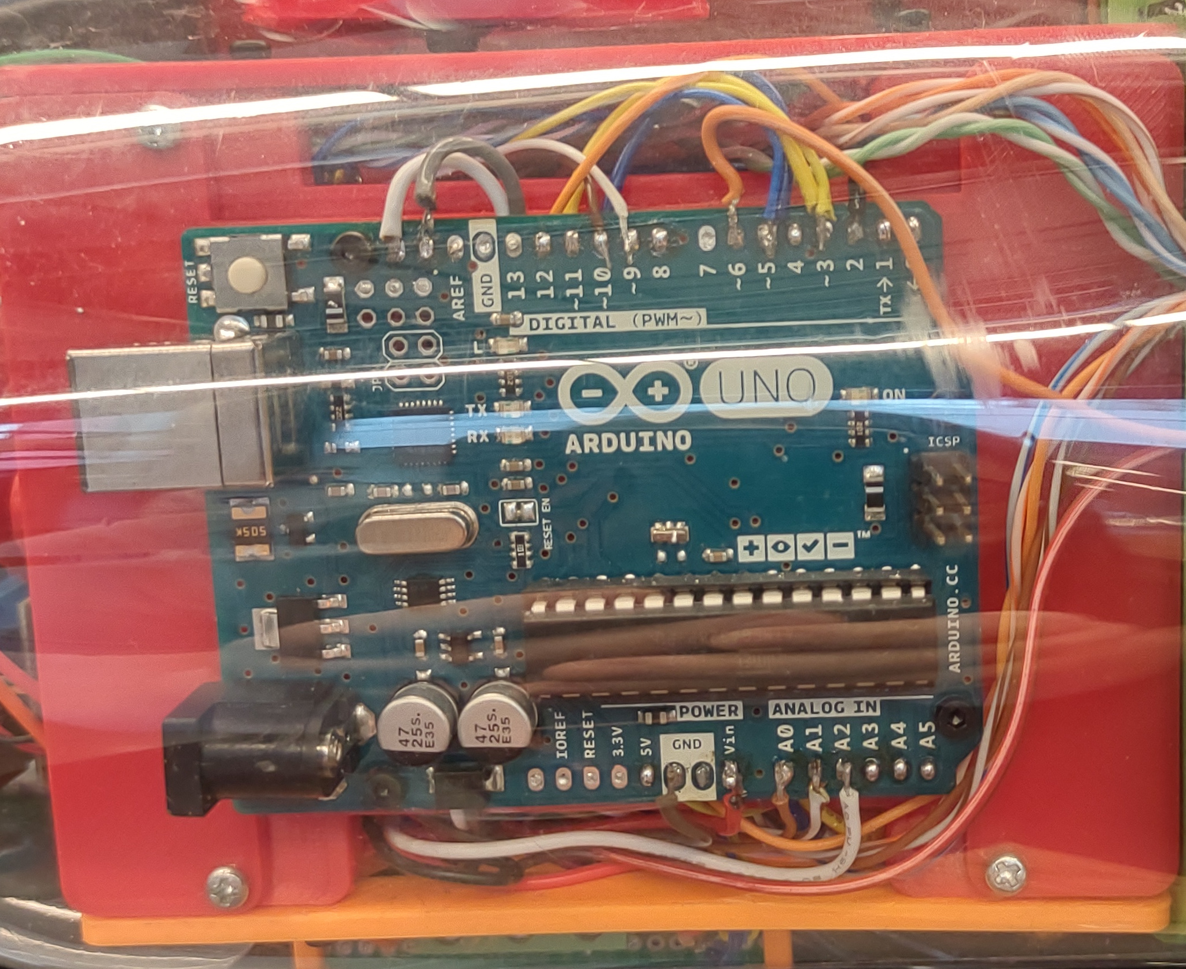
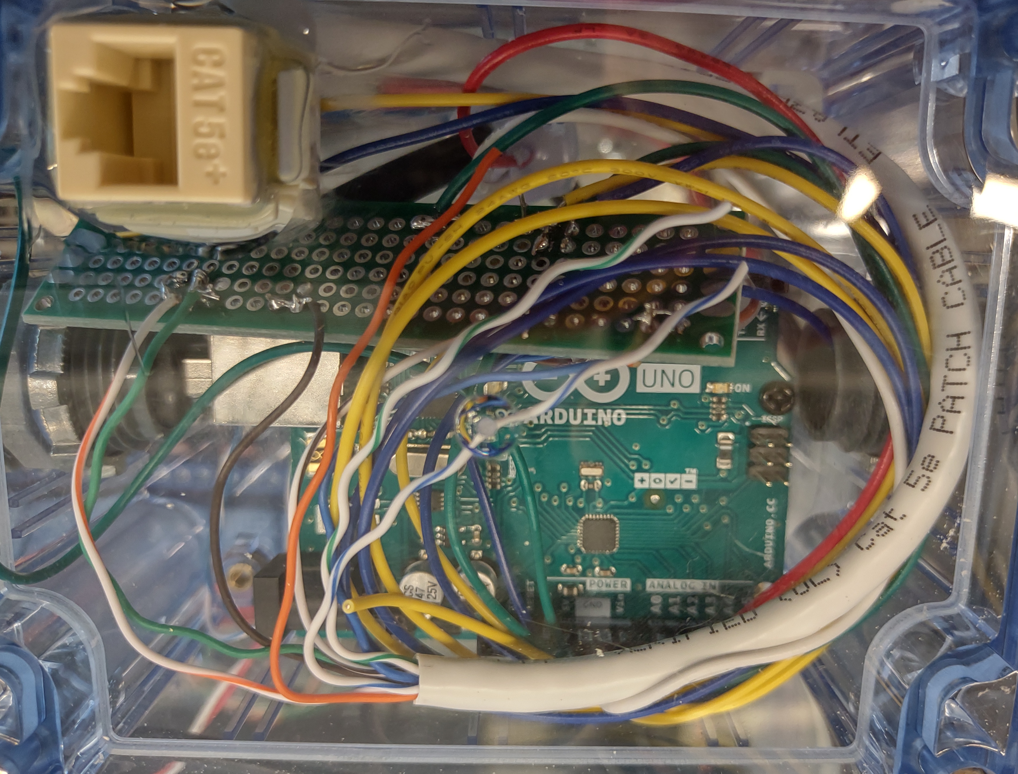
Software
Turbine Arduino
Load Control Arduino
Communicate over UART using a modified Ethernet cable
Turbine sends the load controller a command
Increase, Decrease, Disable, Maximize
Load controller returns status

Slide 19
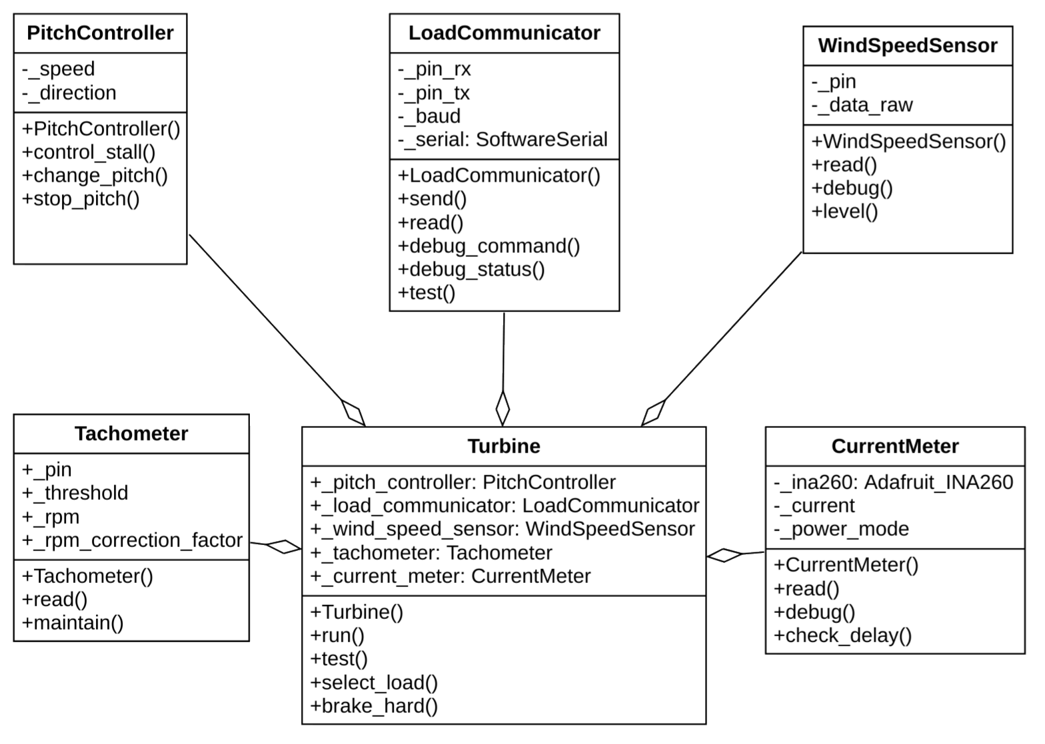
Software: Turbine

Slide 20
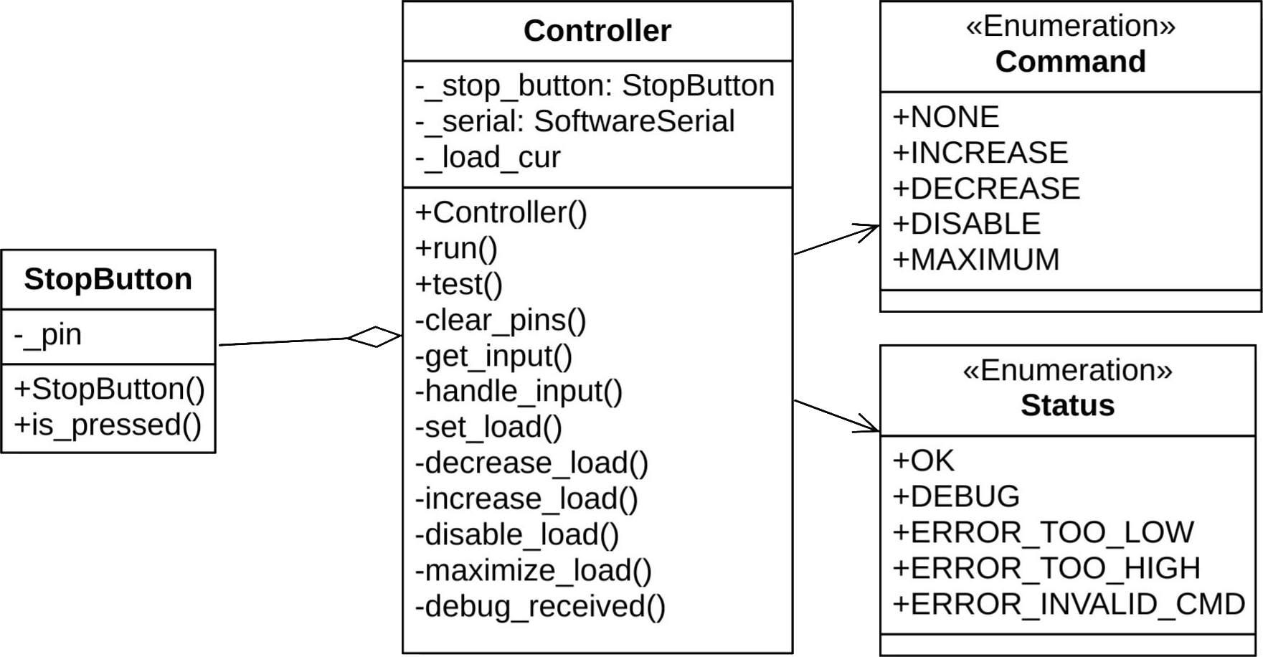
Software: Load Controller

Slide 21
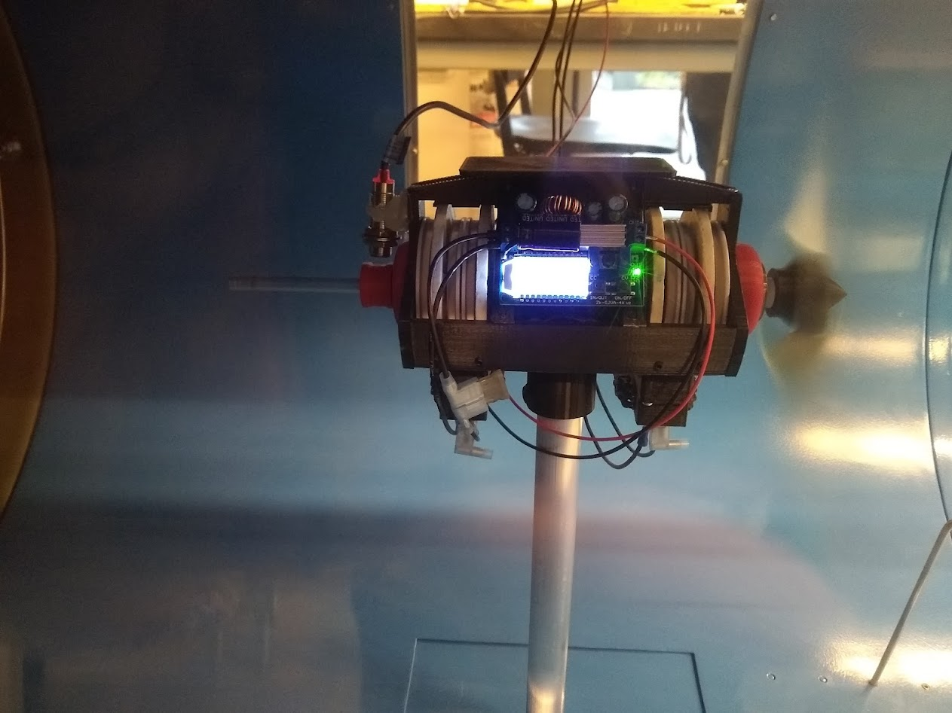
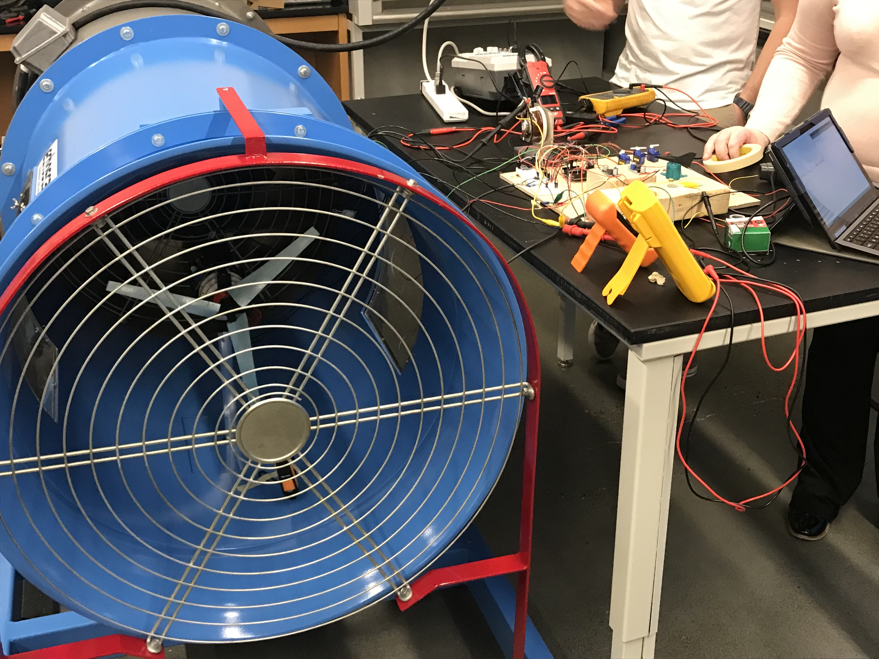
Testing

Slide 22
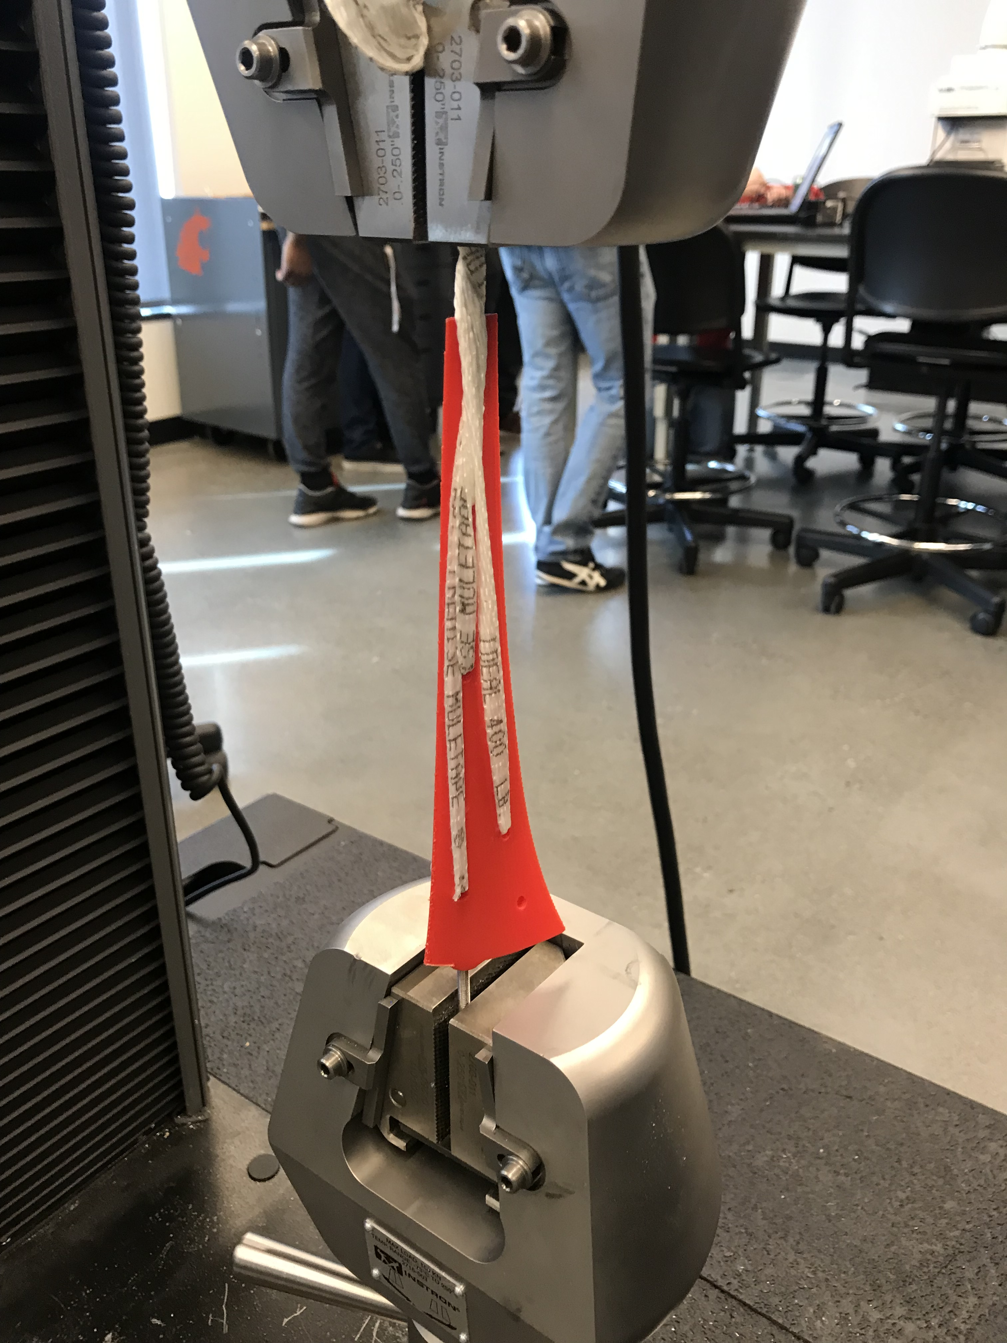
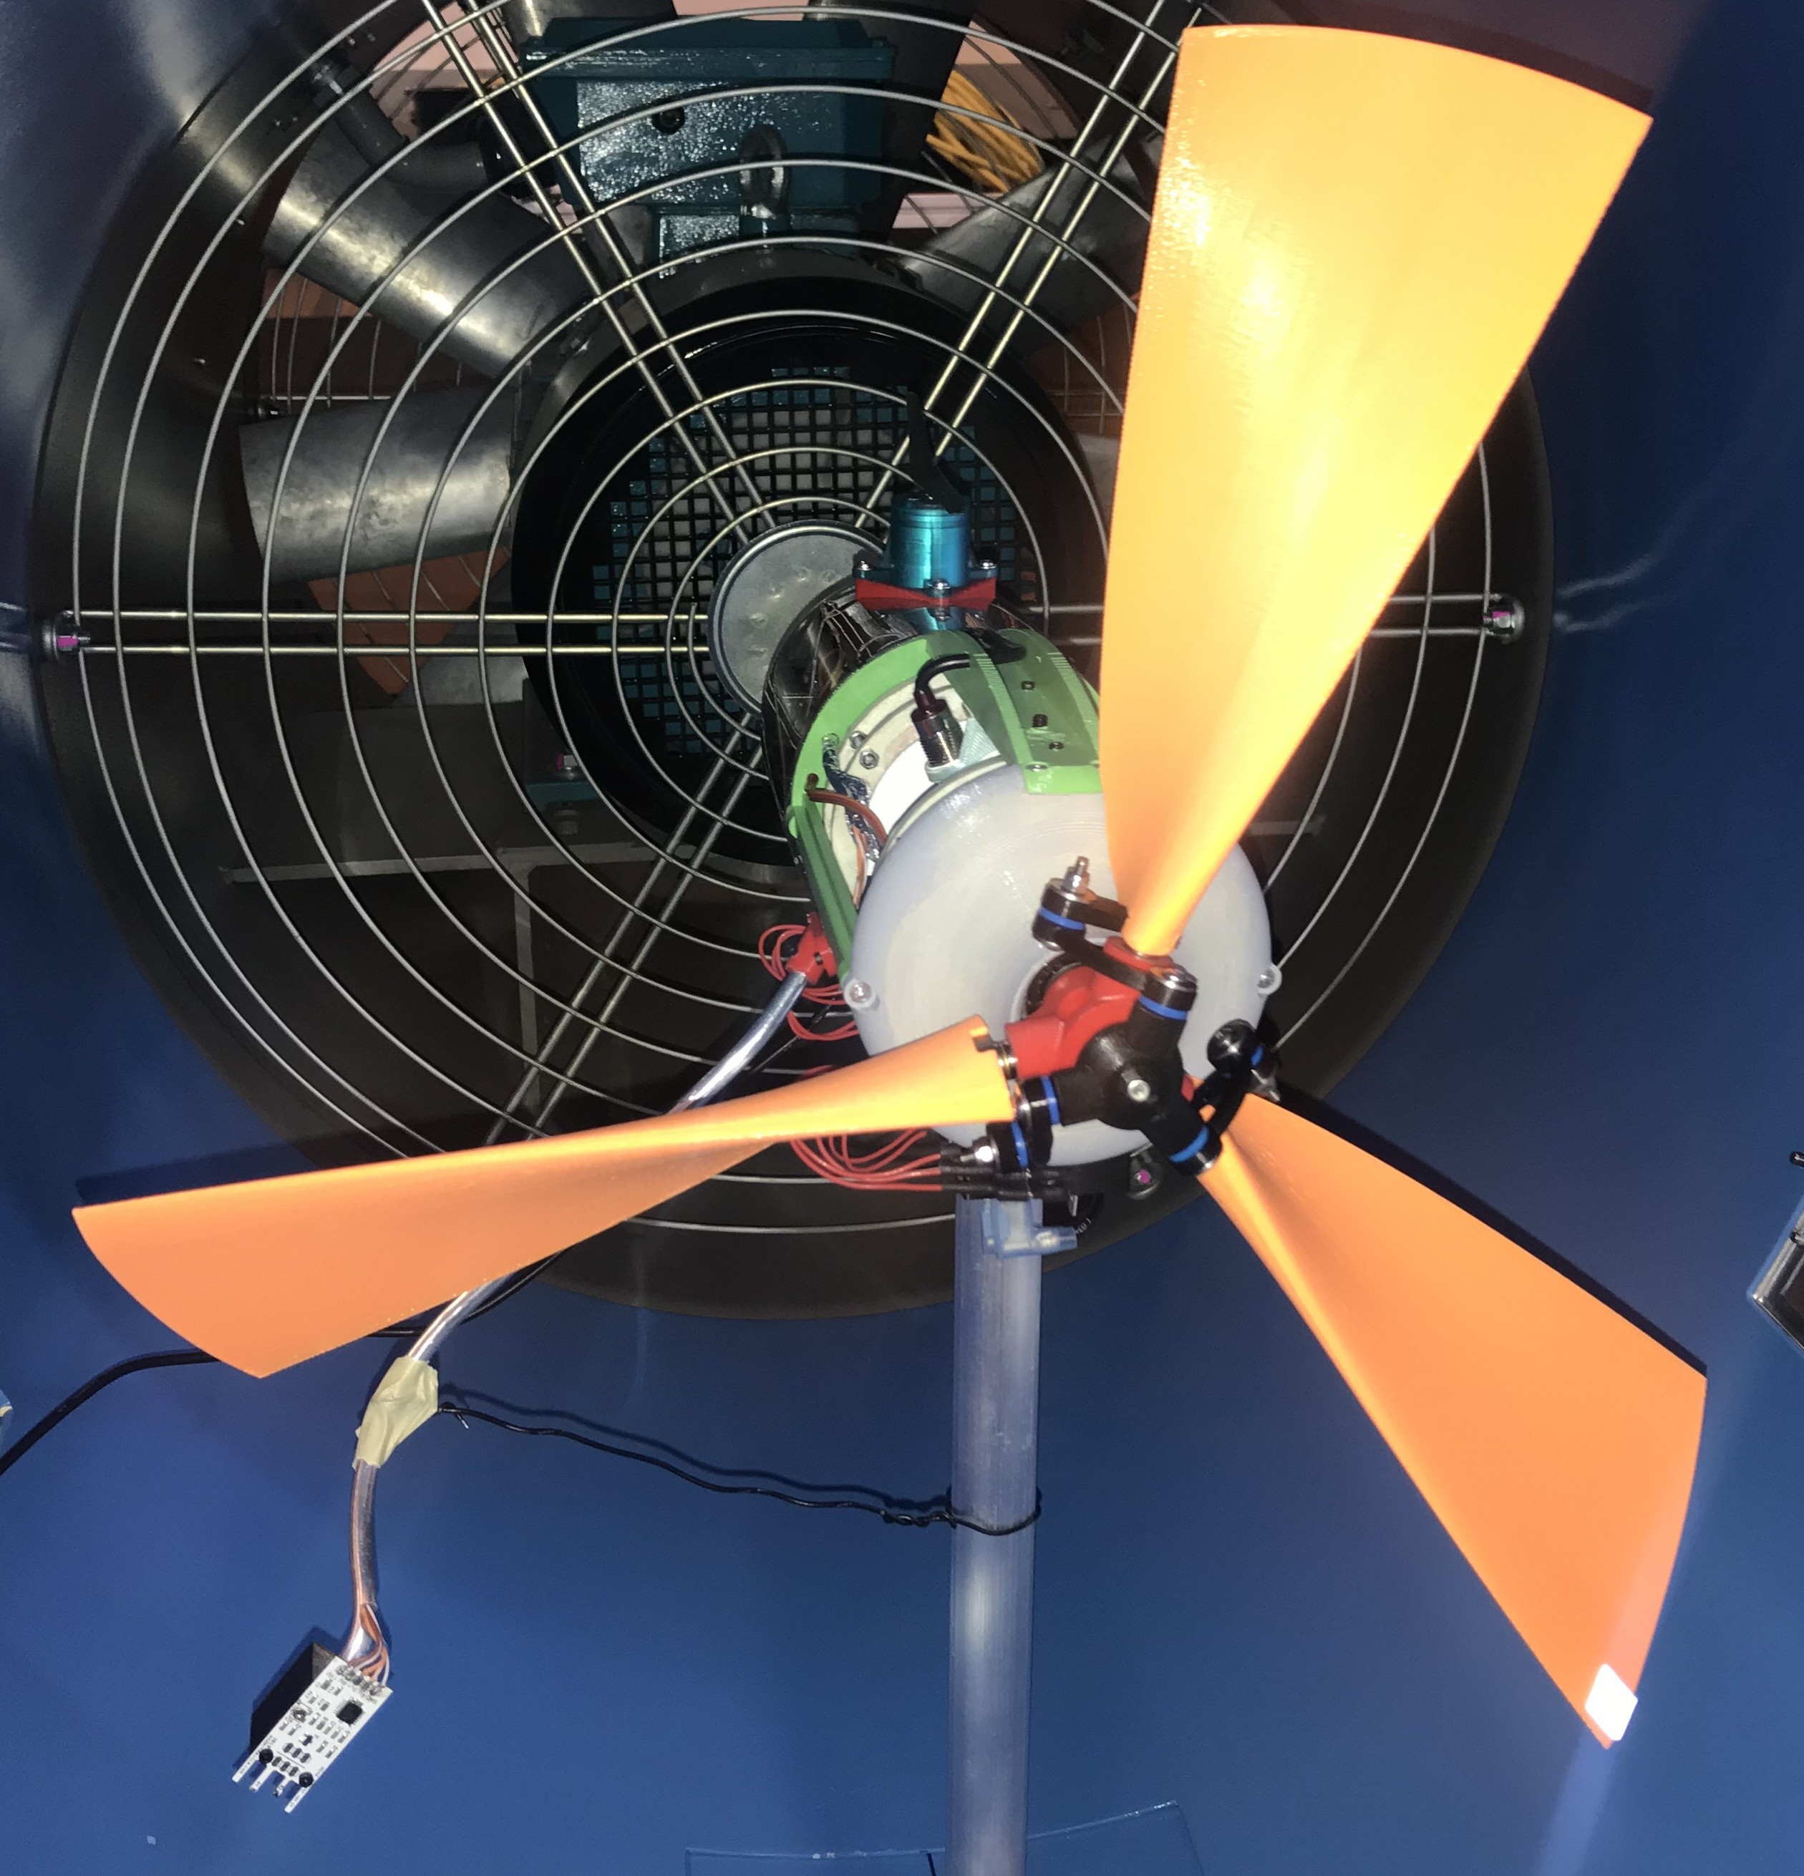
Testing
Tension Test: Need 25 lbf (2000 RPM), Breaking Point: 870 lbf

Slide 23
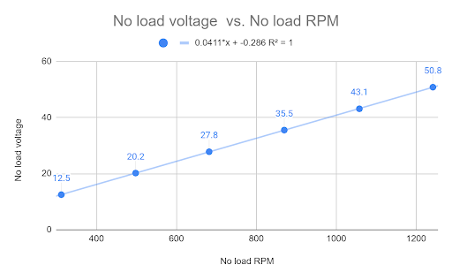
Results
Kv Rating: 24 RPM / V

Slide 24
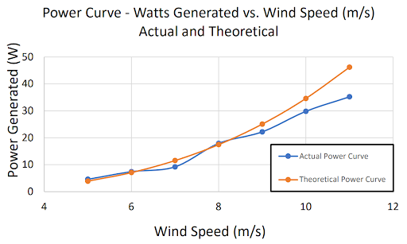
Results

Slide 25
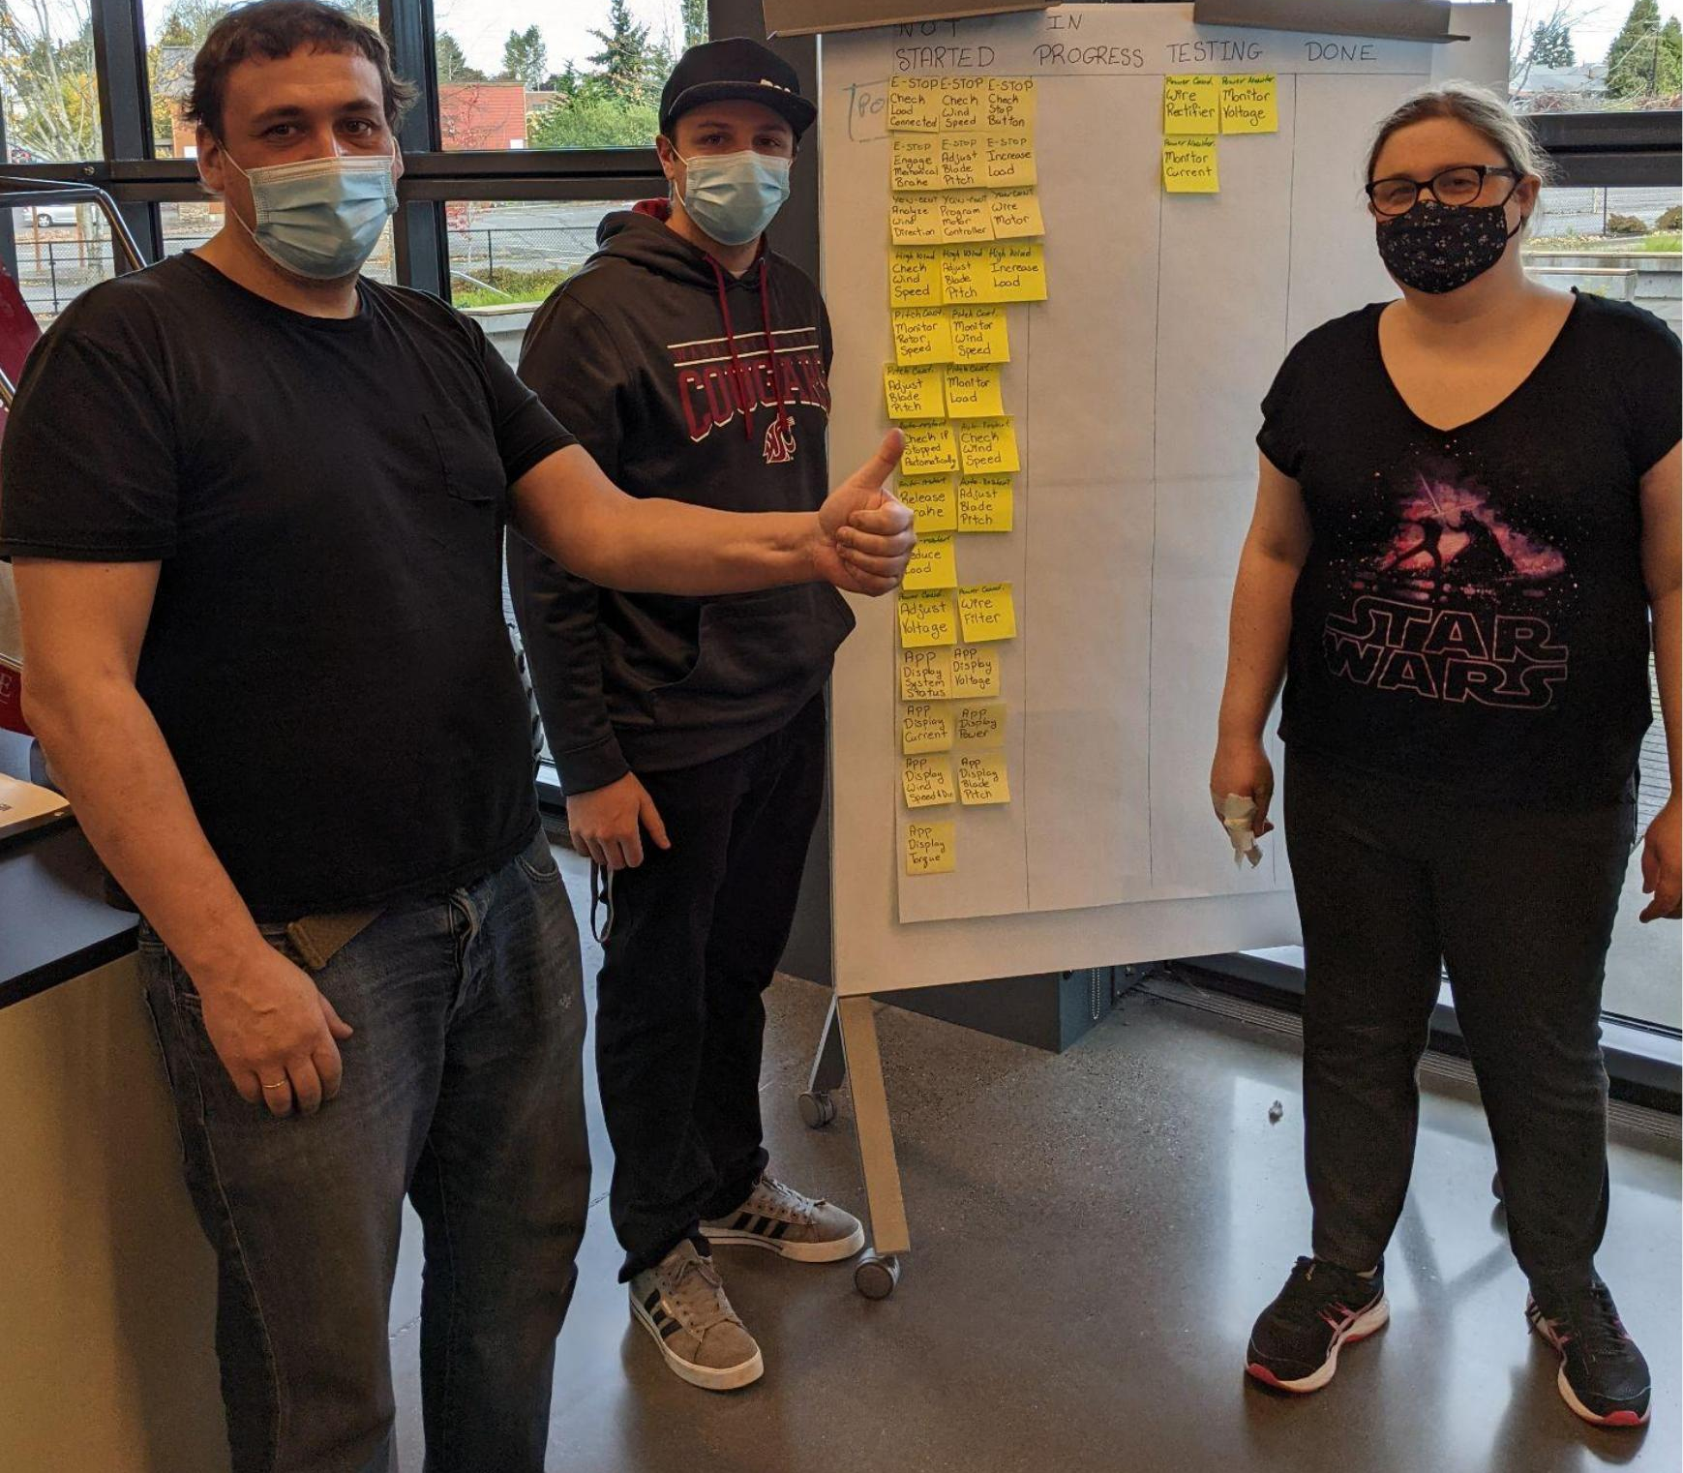
Acknowledgments
Electrical
Boris Gindlin
Steven Fordham
Mechanical
Dan Gilles
Everett Wind Energy Team
Dr. Gordon Taub
Ryan Phillips
Taylor Funk
Quinn Yackulic
James Garfield
Eric Martin
Zach Epperson
Mariana Nicole Tejada
Yulia Fedorchenko
Kaitlin Jones
Garrett Bassen

